Slide 2

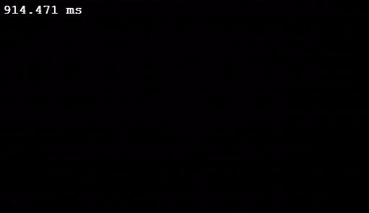
An explanation: Dynamic of surface melting
Evolution of the melt pool for a moving sample during the first line
Empa- LAMP
Empa- LAMP
Evolution of the melt pool for a moving sample – return with 90% overlap
Materials processing with intelligent systems (MICRO-457) Shevchik S. & Hoffmann P.

Slide 3
Another explanation: Dynamic of laser welding
Slow motion - laser welding of different materials with high power LED illumination
https://www.youtube.com/watch?v=mHjn5xIuFko&feature=emb_logo
Materials processing with intelligent systems (MICRO-457) Shevchik S. & Hoffmann P.

Slide 4
Another explanation: Dynamic of plasma plume
Another high speed camera video
Plasma expansion and spatter during Al composite laser welding
https://www.youtube.com/watch?time_continue=38&v=BKdaBRkz8Vo&feature=emb_logo
Empa- LAMP
Materials processing with intelligent systems (MICRO-457) Shevchik S. & Hoffmann P.

